Slide 1
The Basics of the Bible Principle of Trust in Church Organization
Ephesians 4:11-16 “And he gave some, apostles; and some, prophets; and some, evangelists; and some, pastors and teachers; For the perfecting of the saints, for the work of the ministry, for the edifying of the body of Christ: Till we all come in the unity of the faith, and of the knowledge of the Son of God, unto a perfect man, unto the measure of the stature of the fulness of Christ: That we henceforth be no more children, tossed to and fro, and carried about with every wind of doctrine, by the sleight of men, and cunning craftiness, whereby they lie in wait to deceive; But speaking the truth in love, may grow up into him in all things, which is the head, even Christ: From whom the whole body fitly joined together and compacted by that which every joint supplieth, according to the effectual working in the measure of every part, maketh increase of the body unto the edifying of itself in love. This I say therefore, and testify in the Lord, that ye henceforth walk not as other Gentiles walk, in the vanity of their mind, Having the understanding darkened, being alienated from the life of God through the ignorance that is in them, because of the blindness of their heart: Who being past feeling have given themselves over unto lasciviousness, to work all uncleanness with greediness. But ye have not so learned Christ; If so be that ye have heard him, and have been taught by him, as the truth is in Jesus: That ye put off concerning the former conversation the old man, which is corrupt according to the deceitful lusts; And be renewed in the spirit of your mind; And that ye put on the new man, which after God is created in righteousness and true holiness.”

Slide 2

Trust
Something committed to a person’s care for use or management, and for which an account must be rendered. Every man’s talents and advantages are a trust committed to him by his Maker, and for the use or employment of which he is accountable.
Notes:
This is an accurate definition of the trust BLC uses. It is from the 1828 Webster’s Dictionary. Law in America recognizes this type of trust in the church context. Churches in America have been using it for a long time as will be pointed out in the Second Session.

Slide 3
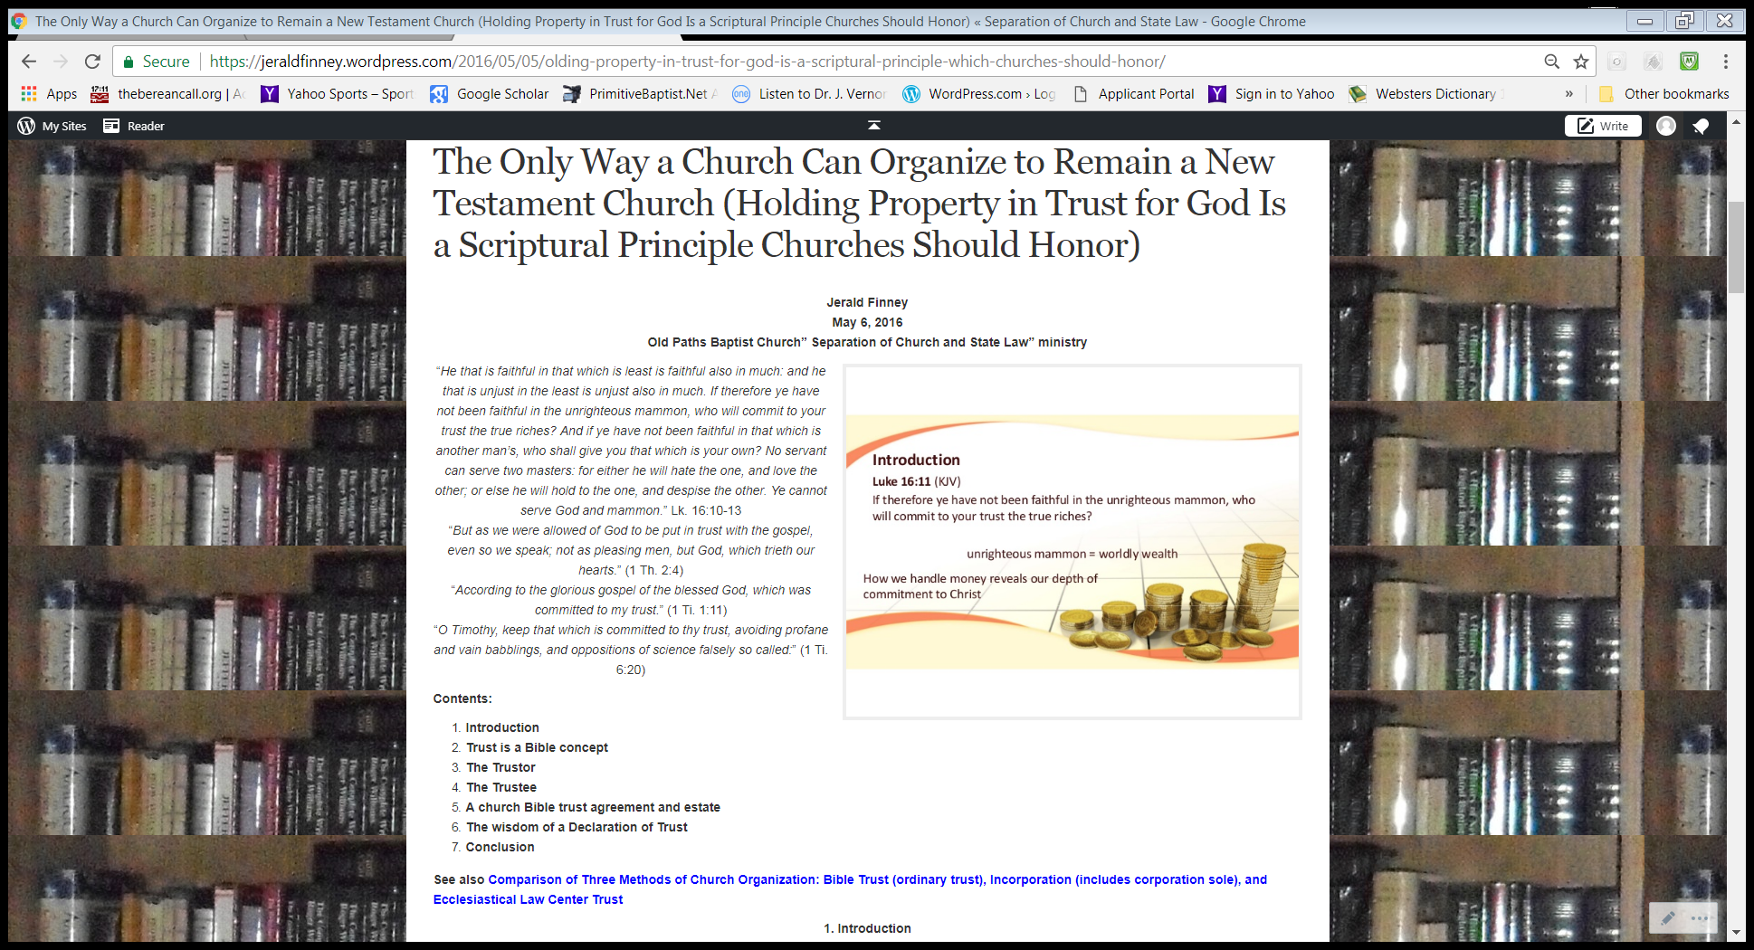
Article at: https://jeraldfinney.wordpress.com/2016/05/05/olding-property-in-trust-for-god-is-a-scriptural-principle-which-churches-should-honor/
Notes:
Not going to cover this in detail, but just let me say that God ordained or established the concept and it is still in force. Who created all things? Who created man. Did God own all things? Does He still own all things? Whom did God entrust the earth and all that is in it? Is the earth and all that is in it still entrusted to man? For whose benefit is it all to be used? Trustor, trustee, beneficiary, duty? This is all explained in this article which is available online at no cost.

Slide 4
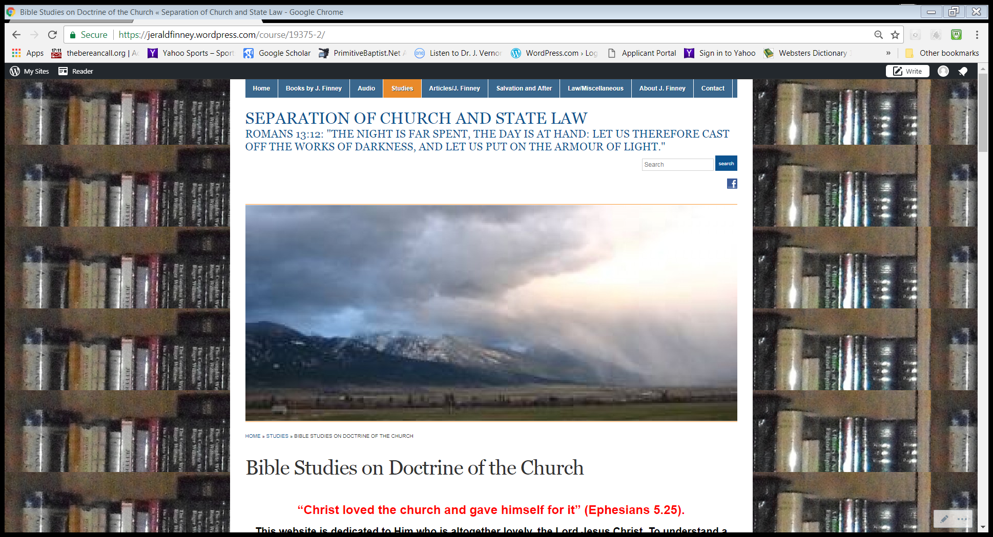
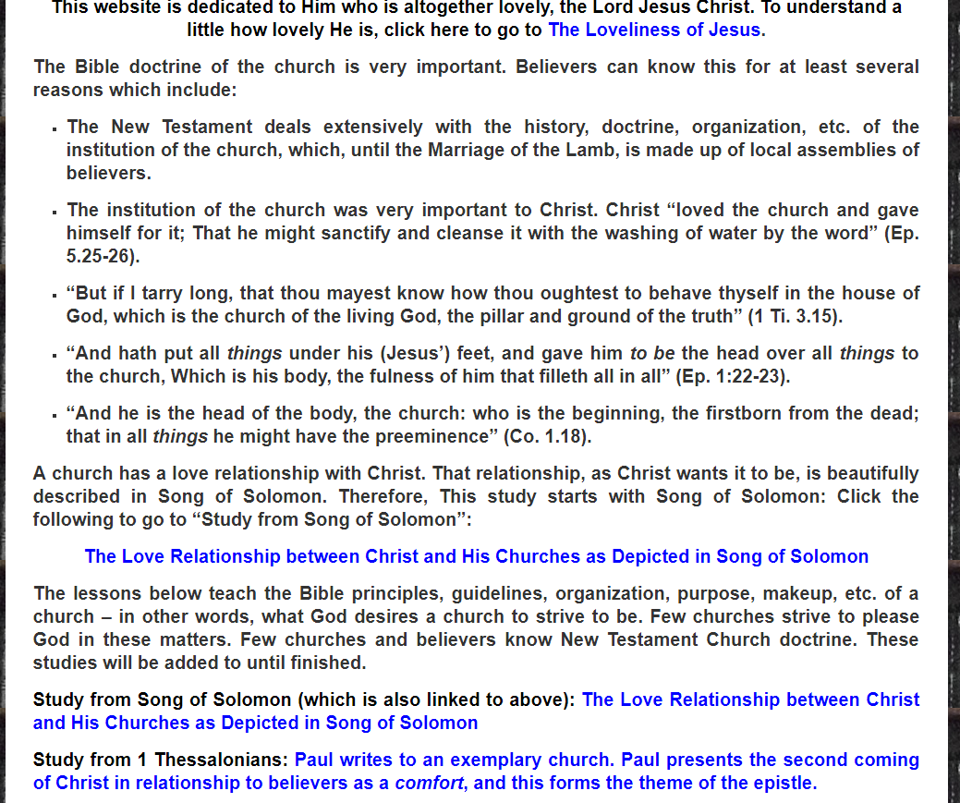
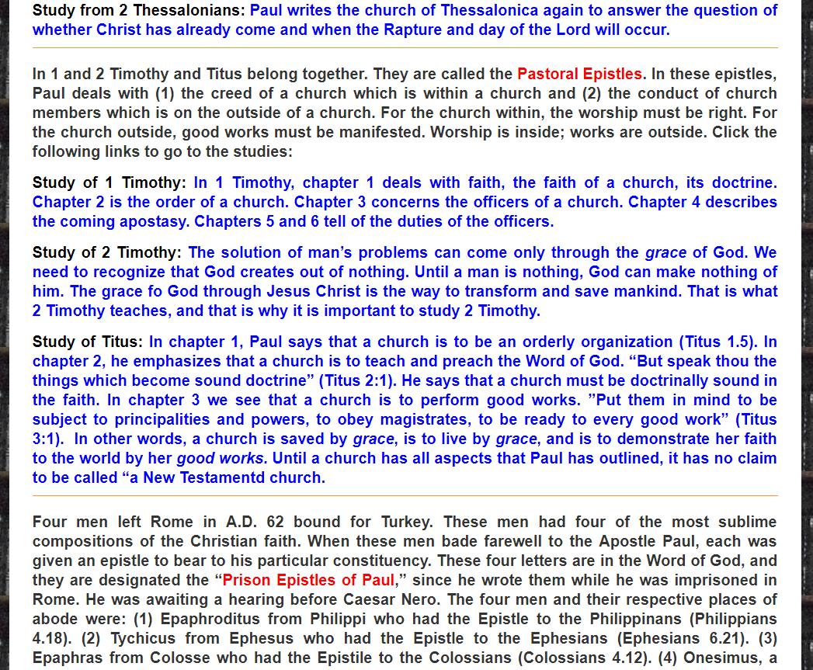
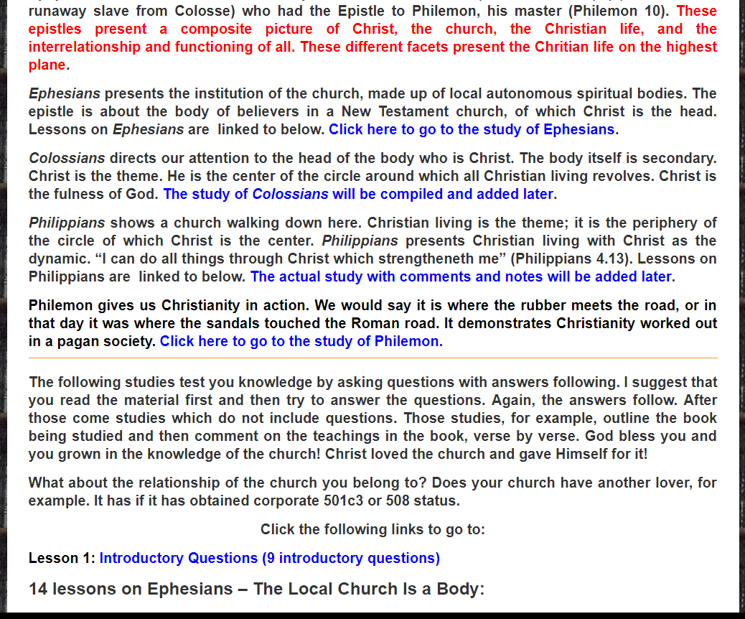
Notes:
I am doing in depth studies of the doctrine of the church, which include studies of the relationship of church and state. I have already done a lot of study on this. I had to in order to glorify God in this ministry He called me into. With increased study comes increased understanding. I am coming across nothing in these more in depth studies which contradicts my conclusions: God desires total separation of “church and state” (not separation of God and state). I explain what this means in some detail in some of my writings (give examples, perhaps). Maybe elaborate a little on the importance of understanding this if time permits, etc. Make comments as I go through the pages on this slide.

Slide 5
Does God desire, according to the principles in the NT, a church to be a spiritual or a legal entity?
I believe that the New Testament clearly teaches that a church is to be a spiritual entity only. If you disagree, you are free to put your church under civil government. You, like the Catholics and her harlot offspring may as well combine with civil government. Note: Any type of church incorporation grieves our Lord. However, church incorporation now (any “church” can choose to become a state church) differs from that in the colonies (only one state church was allowed-“heretics” were persecuted). Note: God desires union of God and state, not union of church and state.

Slide 6
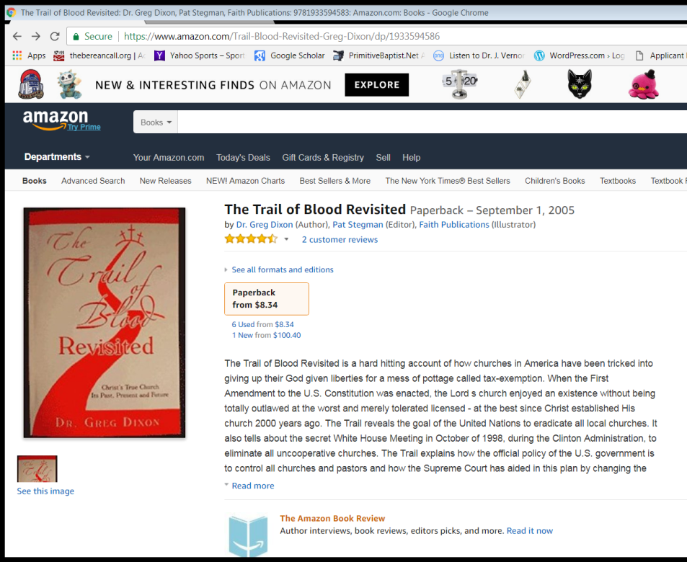
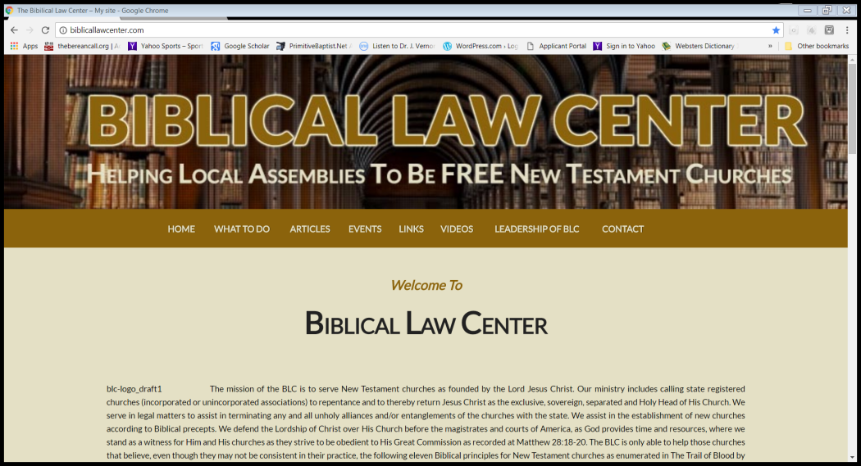
Where To Go For Answers
Notes:
Spontaneous personal recollection

Slide 7
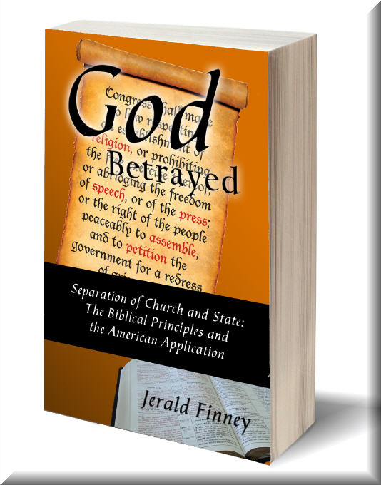
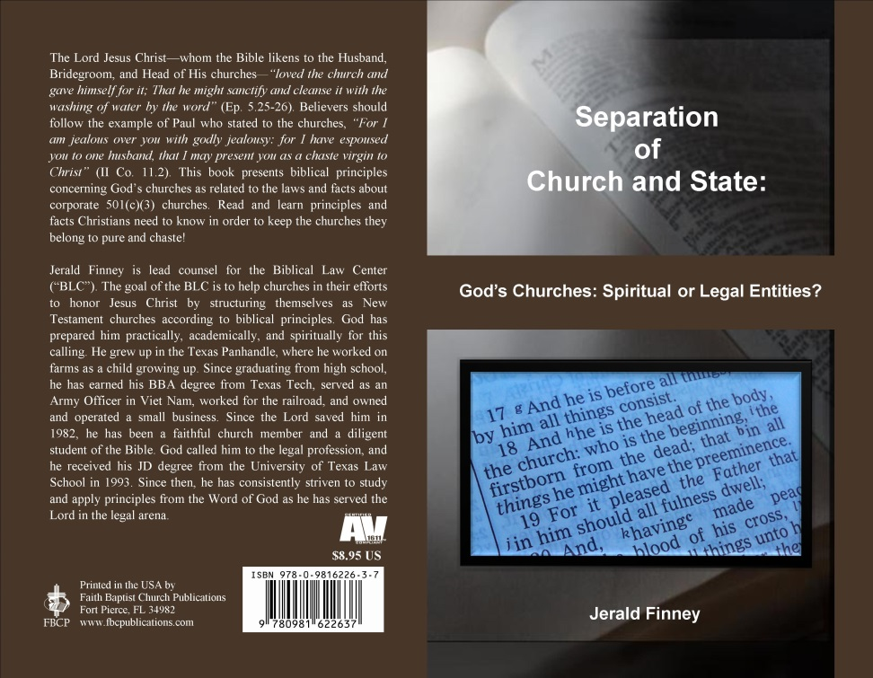
Where To Go For Answers
Notes:
Go to my books for answers. But before that or along with that, you should first do some things which I will mention later in this presentation. Check everyone out before believing and following them. Everyone includes me.

Slide 8
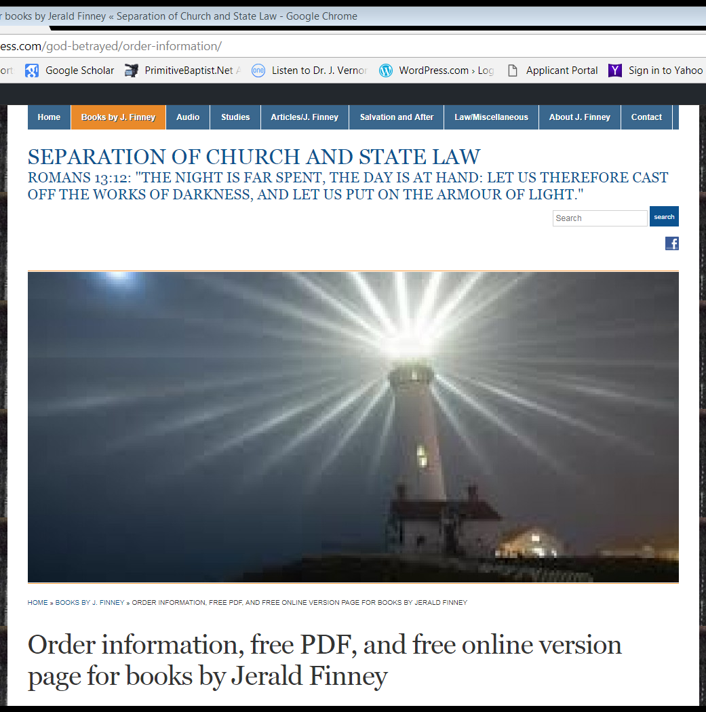
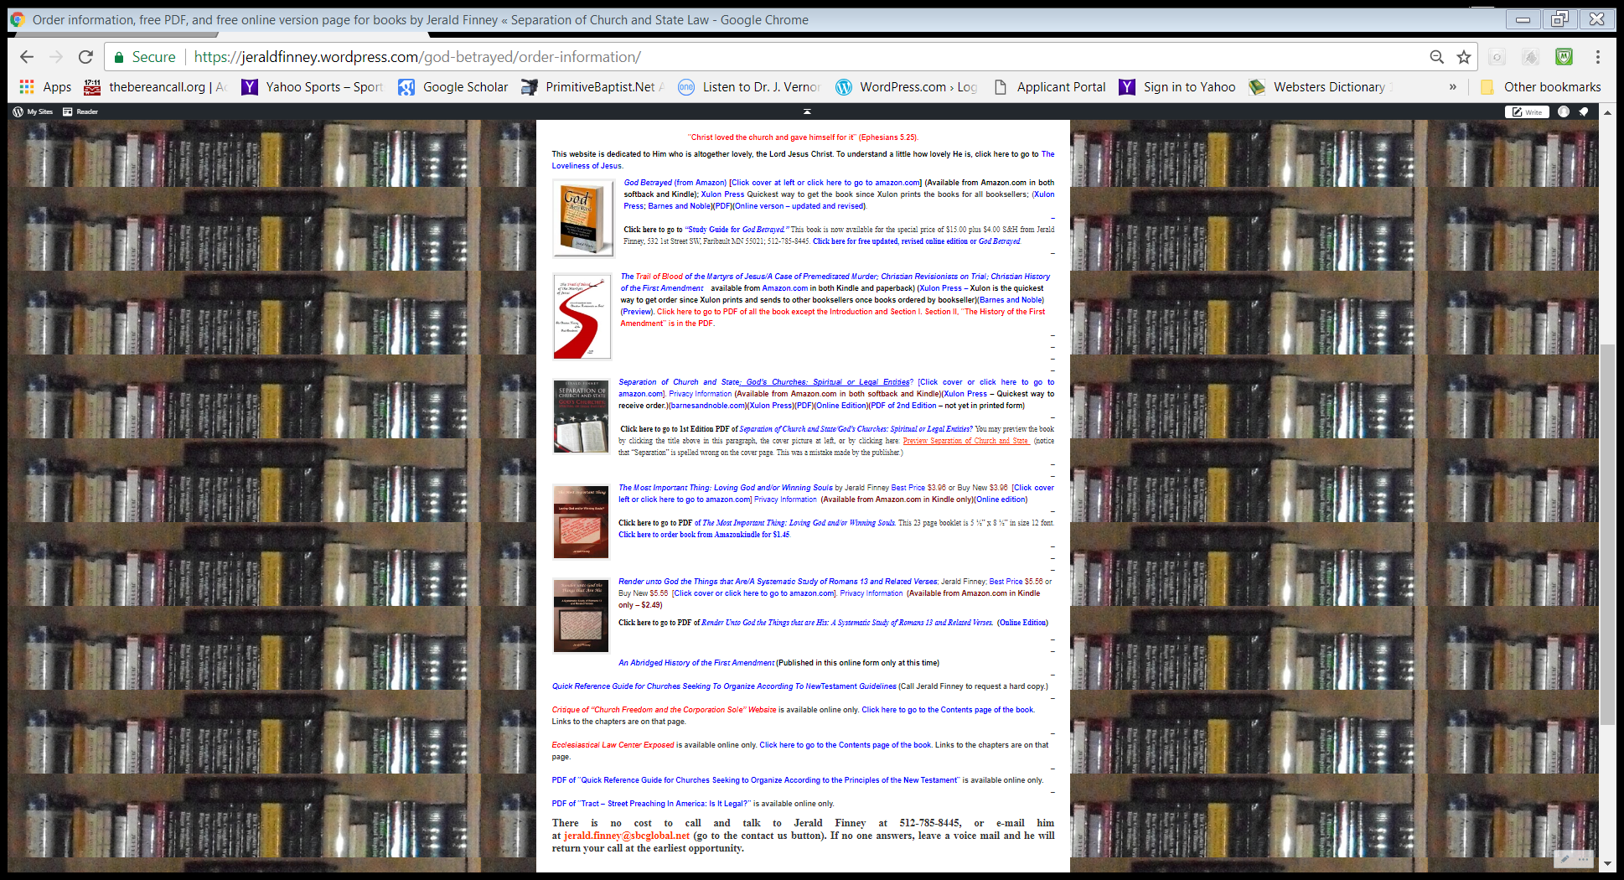
Where To Go For Answers
Notes:
All my books are free. Some can be bought, if you so desire. However, you can get them free in online form or PDF. Here is the page to go to where you can get access to all books in whatever form. God’s website, “Separation of Church and State Law,” also has many other resources such as articles, links to sermons, and so forth. Jeraldfinney.wordpress.com.

Slide 9
What Is a Trust?
I asked, “What is a trust?”
I did not ask,
“What is a Business Trust.”
I did not ask,
“What is a Charitable Trust?”
The adjectives can make significant changes
in the meaning. How can one know the difference? A business or charitable trust and some other kinds of trusts are legal entities and vary significantly from a “trust.” See if “trust” has an adjective before it. If it does, it may not be a “trust,” but something different from a “trust.” Then check the attributes of the “trust” to see if it is a legal entity.

Slide 10
What Is a Trust?
God originated the concept of trust. See the article.
The law recognizes the concept of “trust.” The law recognizes the attributes of a trust.
The law also adds adjectives to the word “trust.” Those adjectives will let you know if you are dealing with a “trust,” a “business trust,” a “charitable trust,” or some other type of arrangement that is a legal entity.
When the law begins to modify the basic meaning of “trust,” the resultant “____ trust” may actually be a legal entity. A “trust,” as we shall see,” is not a legal entity.

Slide 11
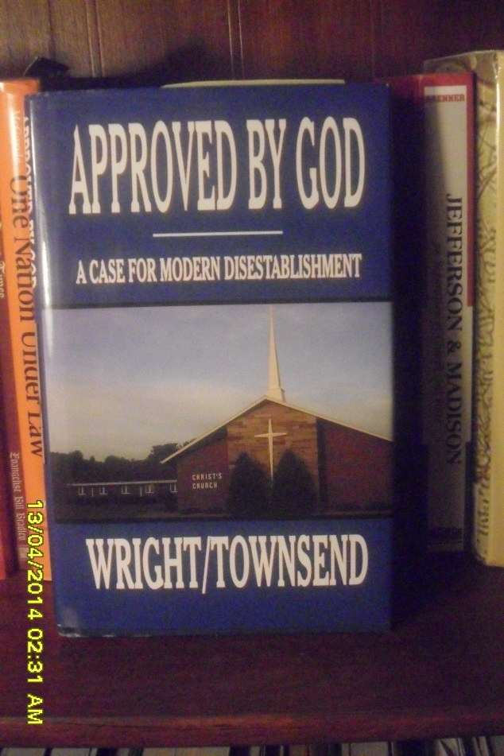
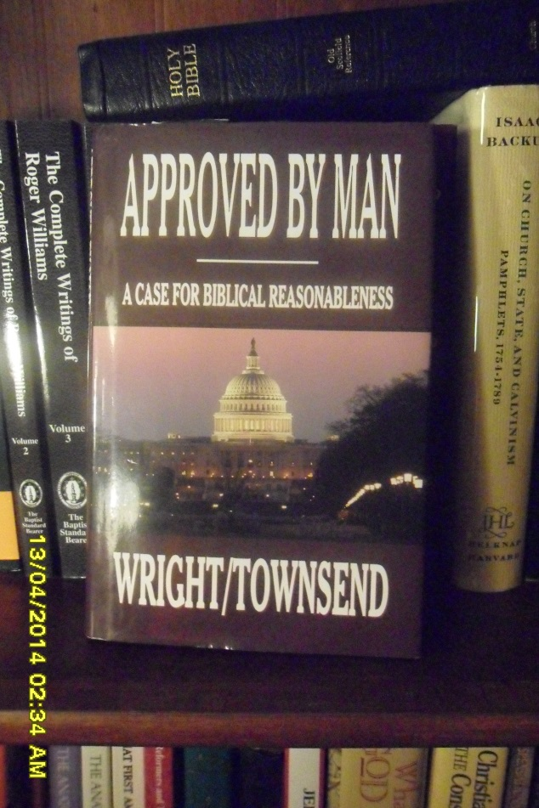
Where not to go for help:
Don’t go here:
Don’t go here:
Notes:
I explain why not to go here in [go to slide 12]

Slide 12
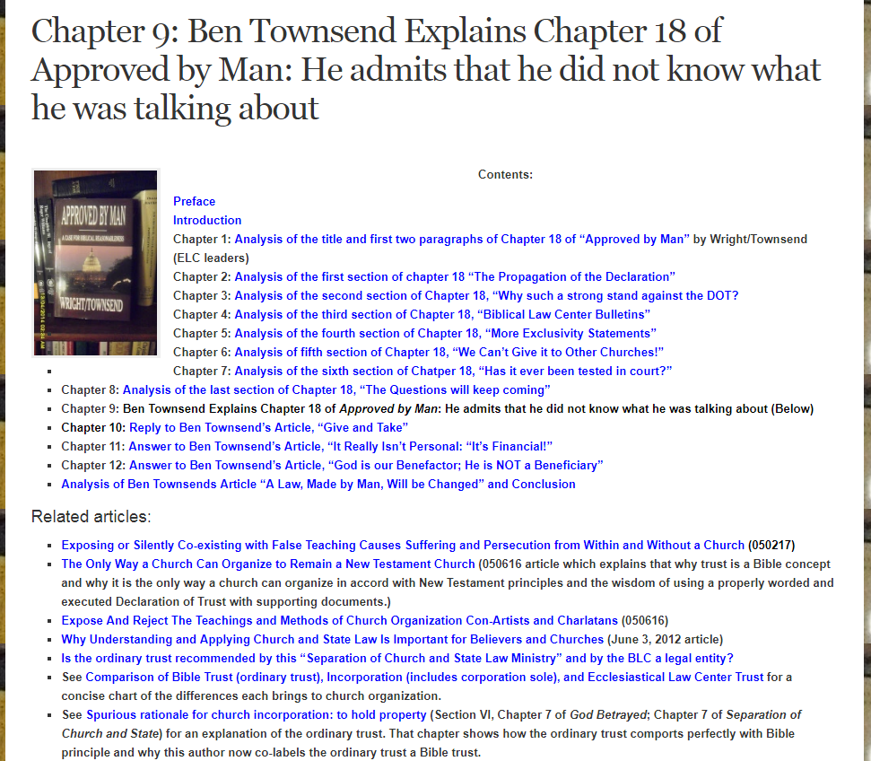
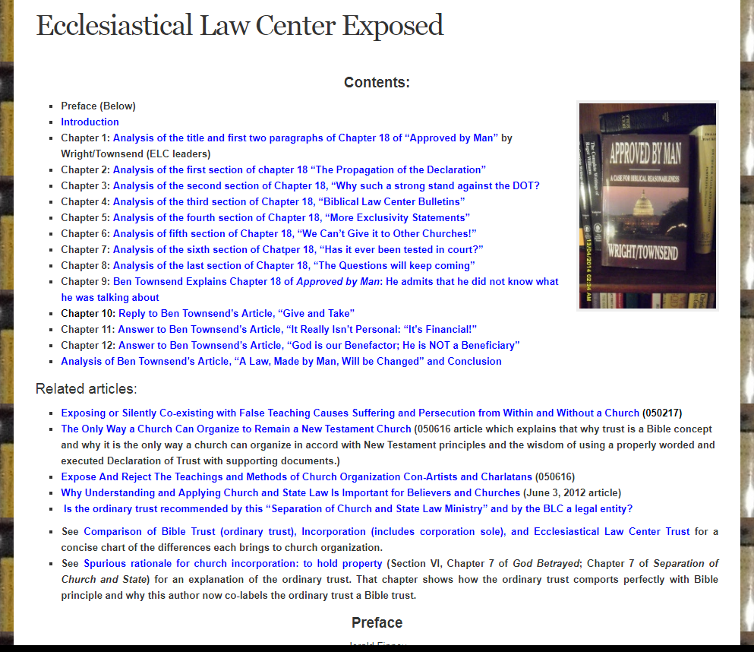
Free online booklet that explains why not to go there.

Slide 13
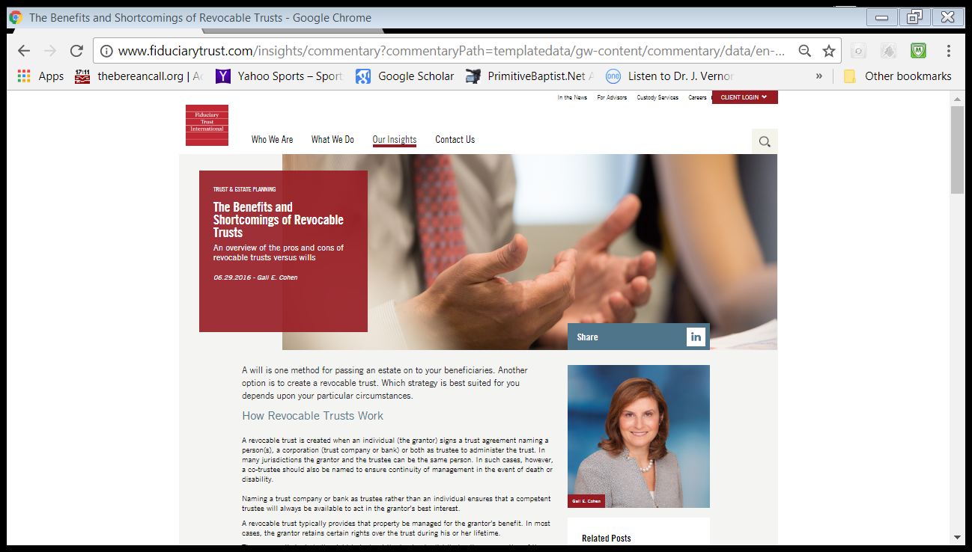
Where not to go for help:
Notes:
It says among other things, “An overview of the pros and cons of revocable trusts versus wills.” Not applicable to the trust we do. However, I would be glad to discuss the concept of revocable versus irrevocable trust in the context of the trust BLC recommends.

Slide 14
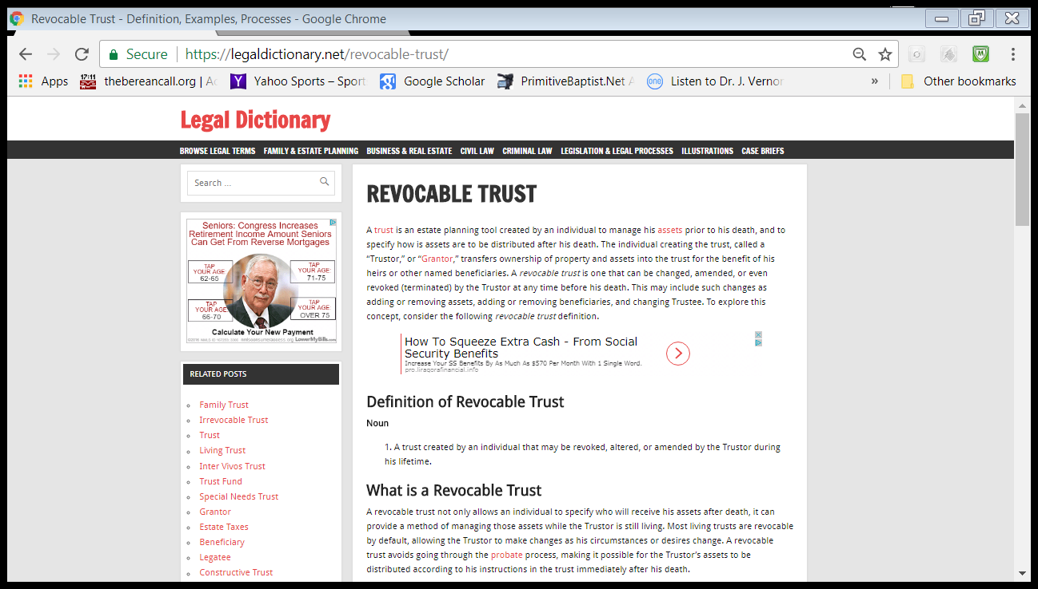
Don’t just start searching on the internet.
Notes:
It says, among other things, “A trust is an estate planning tool created by an individual to manage his assets prior to his death, ….” Not applicable to the BLC recommended trust relationship.

Slide 15
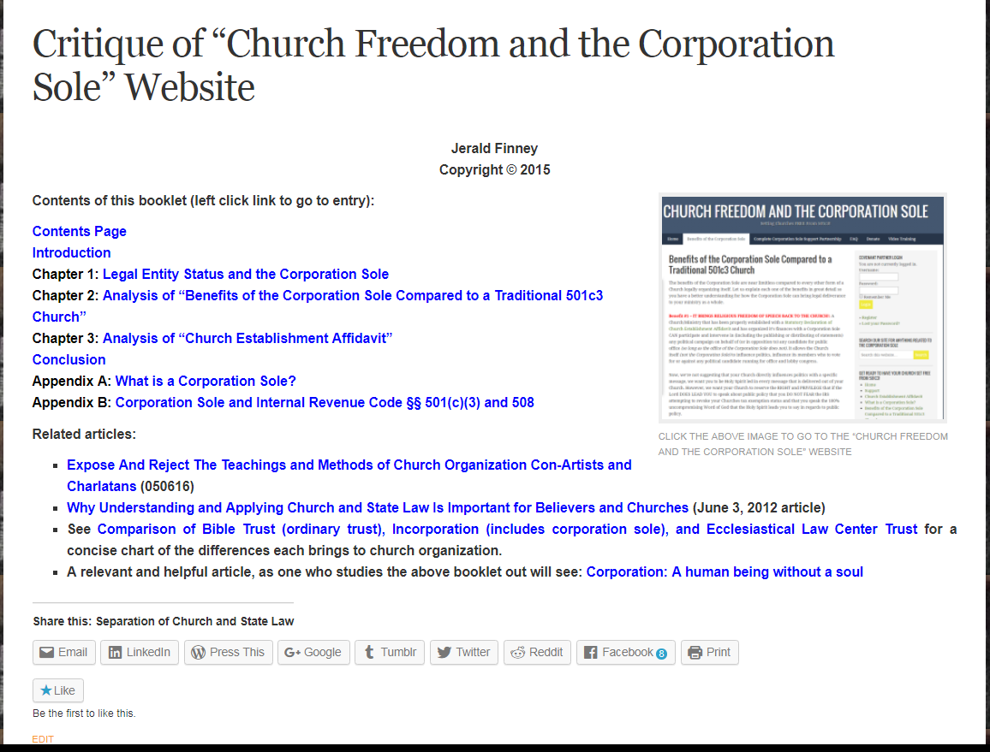
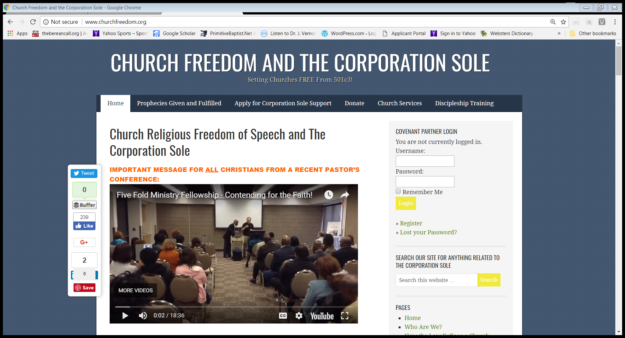
Another place not to go.
Notes:
[Brief comments on this page and corporation sole] E.g. A corporation sole is just another type of non-profit corporation. The one and only difference is that it has only one officer. It says right in the law, quoted in this booklet, exactly that. [Comments on Church Establishment Affidavit.]

Slide 16
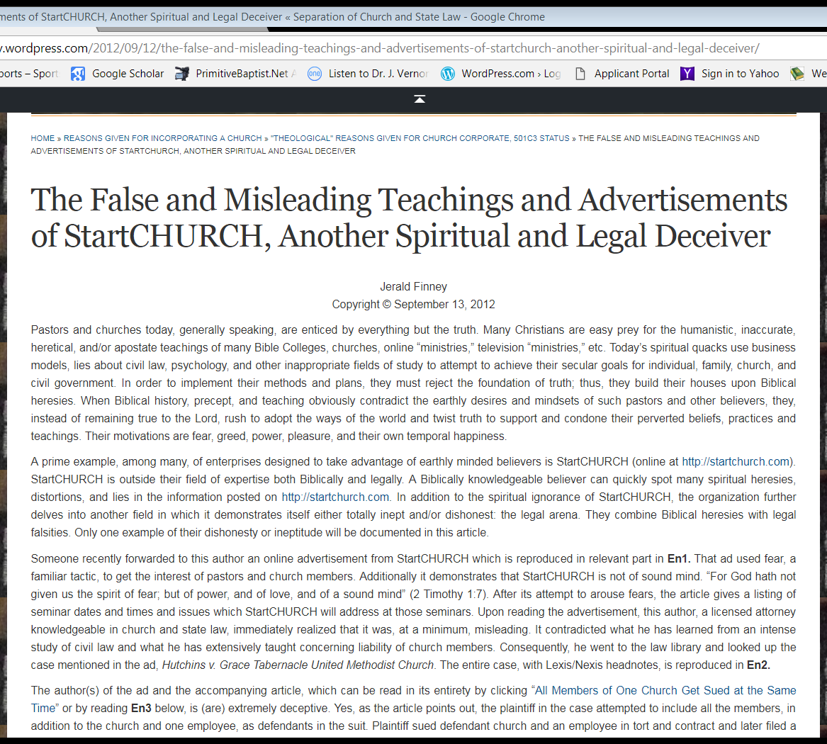
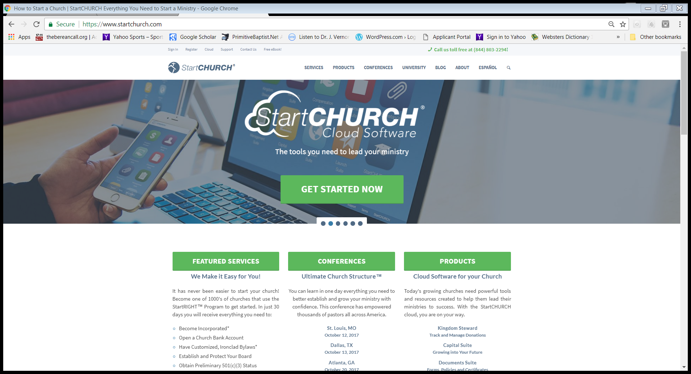
Another place not to go.

Slide 17
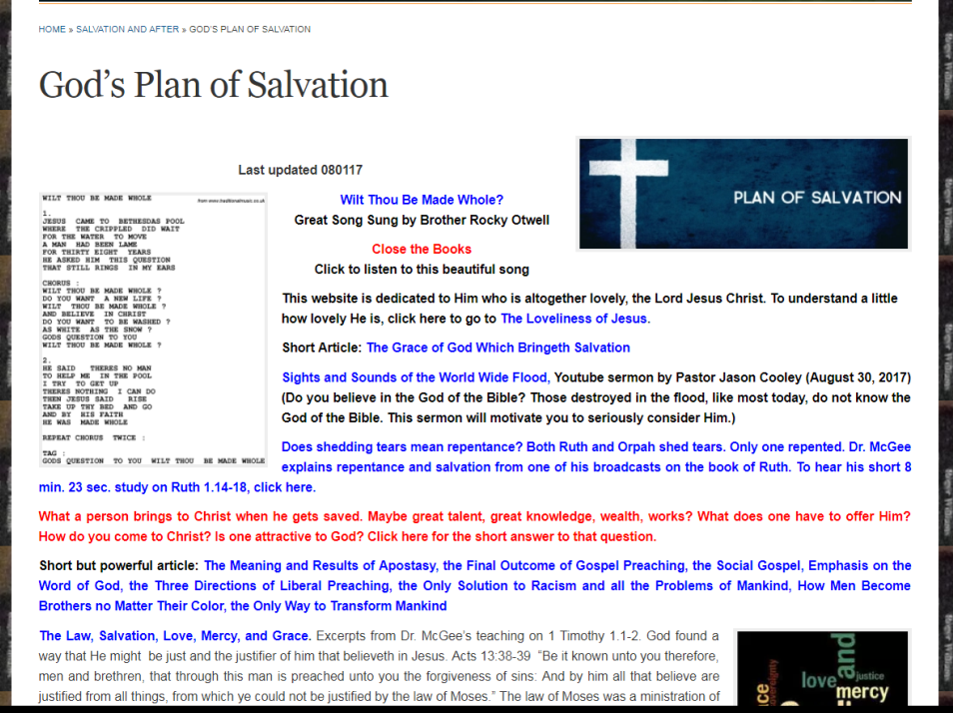
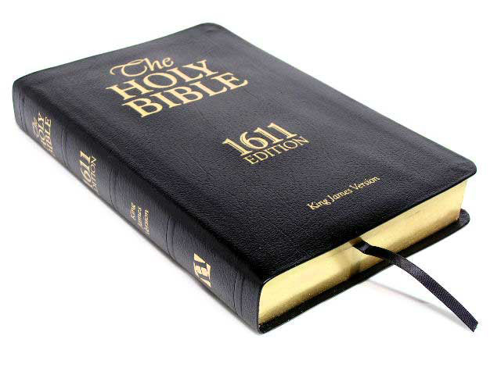
So, what is one to do and where is he to go to learn the truth? I suggest:
If you are lost, get saved:
If saved, “Study to shew thyself approved unto God, a workman that needeth not to be ashamed, rightly dividing the word of truth.”

Slide 18
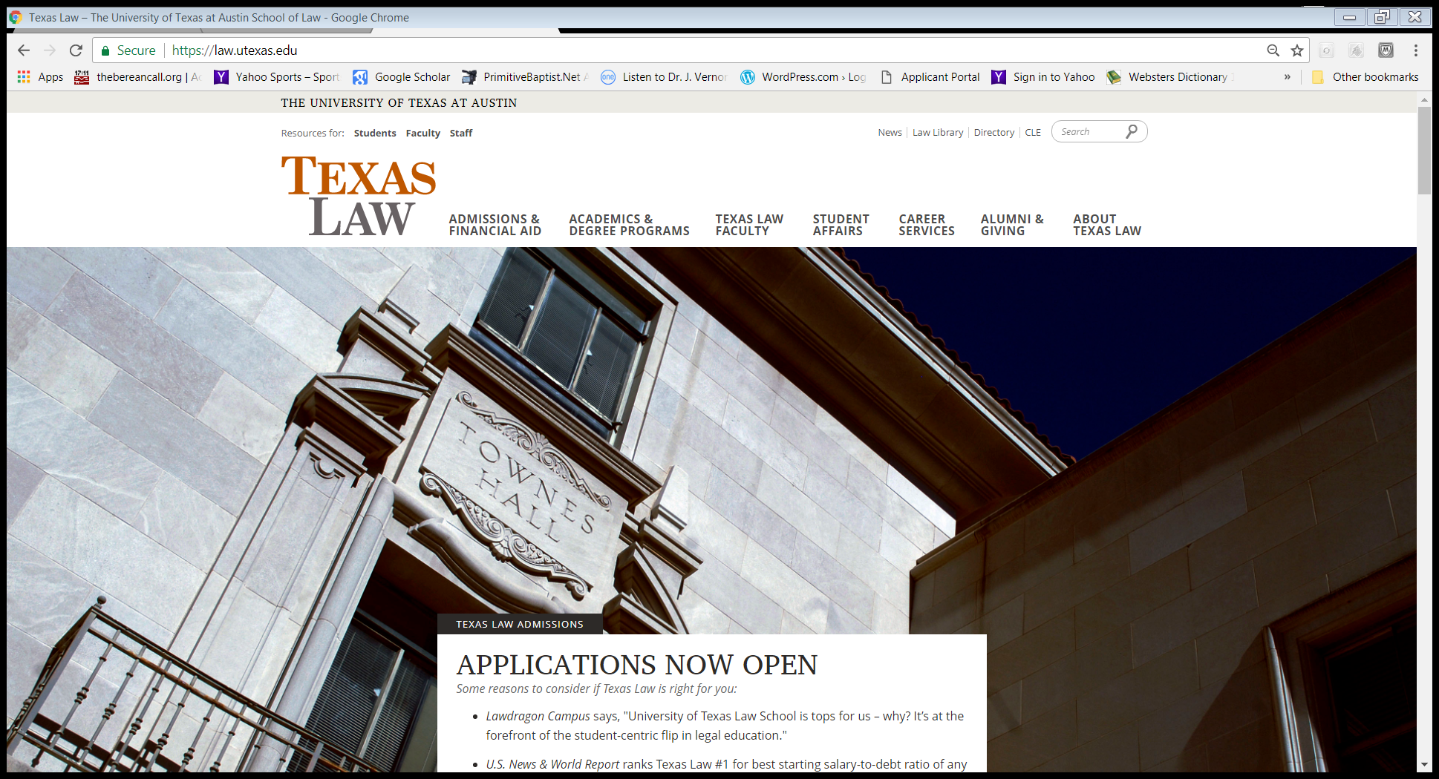
Then what?
Always remember that the standard is the Bible. Always remain an active and faithful member of a Bible believing and Bible preaching church. Learn how to do legal research. Study the law. At first, I studied materials from various Patriot groups and individuals I heard on “Christian” and alternative media. I found serious problems with their teachings. The Lord impressed upon me to go to law school. I wanted to glorify God in this calling. The Lord wanted me to know what I was doing. The Lord wanted me to be able to help others.

Slide 19
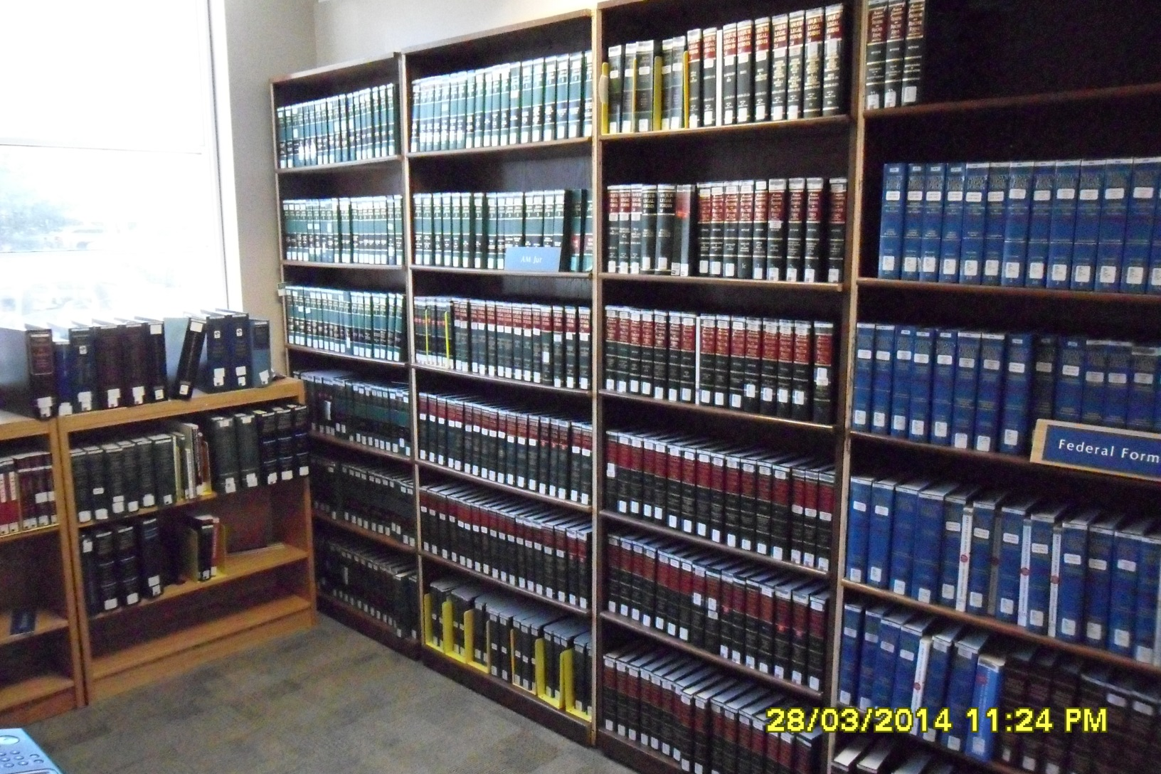
Then what? Study, study, study. Bible first, then
Notes:
Go to the law library now that you know what you are doing. This pictures some resources. Those at the top left are AmJur 2d, a legal encyclopedia. This is just one starting point for legal research. There are many more starting points. It is just a starting point and will lead you to many other resources.

Slide 20
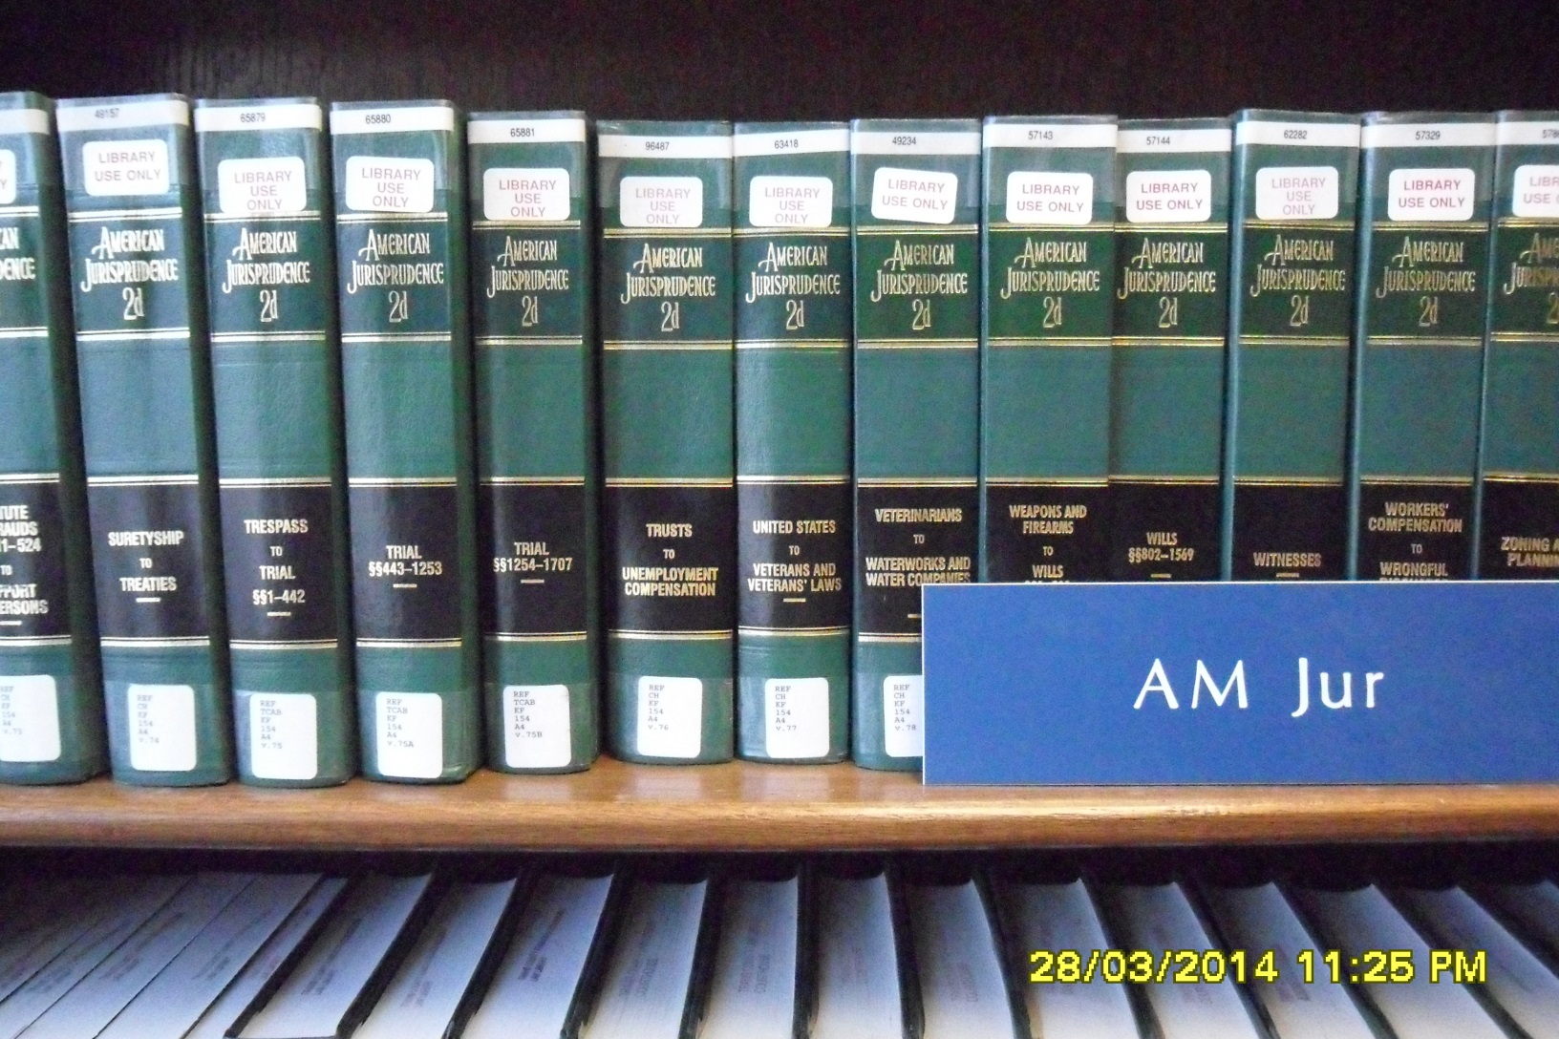
Kinds of Trusts
Notes:
This is a closer view of some volumes of AmJur 2nd.

Slide 21
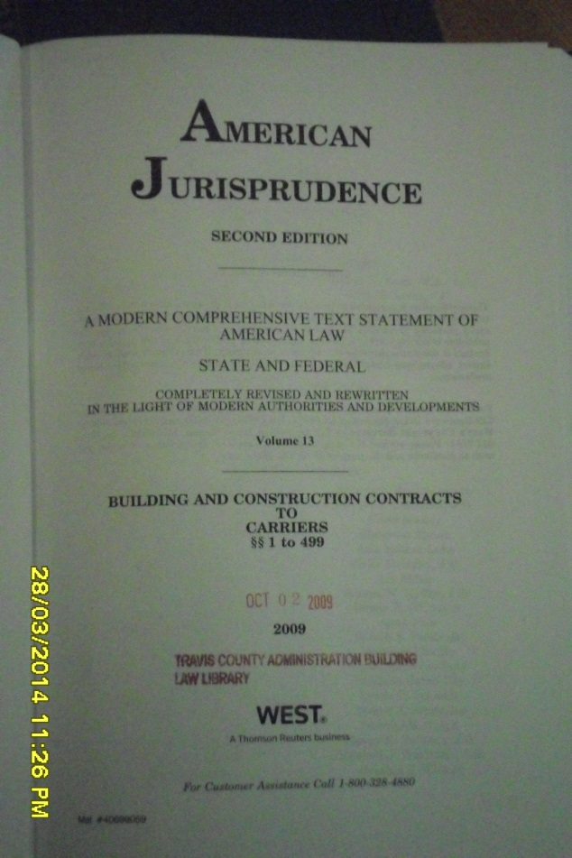
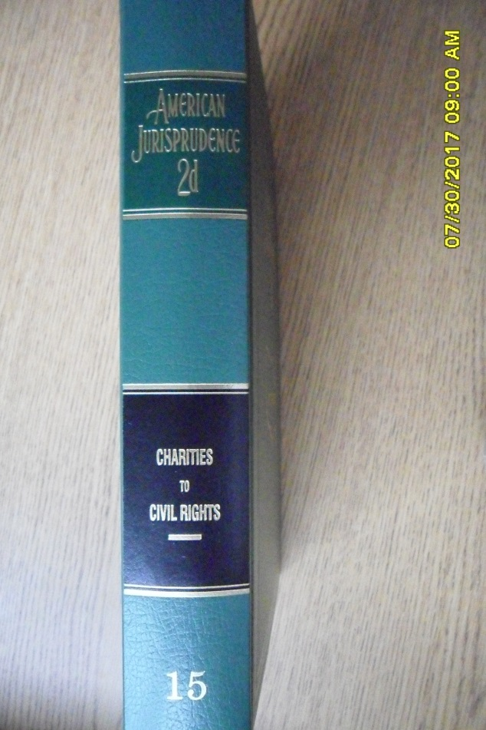
Kinds of Trusts
Don’t go to volume 13
Don’t go to volume 15
Notes:
You need to know where to start. You don’t start with volume 13 “business trusts” or volume 15, “charitable trusts.” Ben Townsend mixes up all kind of trusts in his writings. He says “A dog is a dog.” Yes, but a poodle is not a German Shepherd. Business and charitable trusts are very distinct from each other and from “trusts.”

Slide 22

Go to Volume 76, “Trusts”

Slide 23
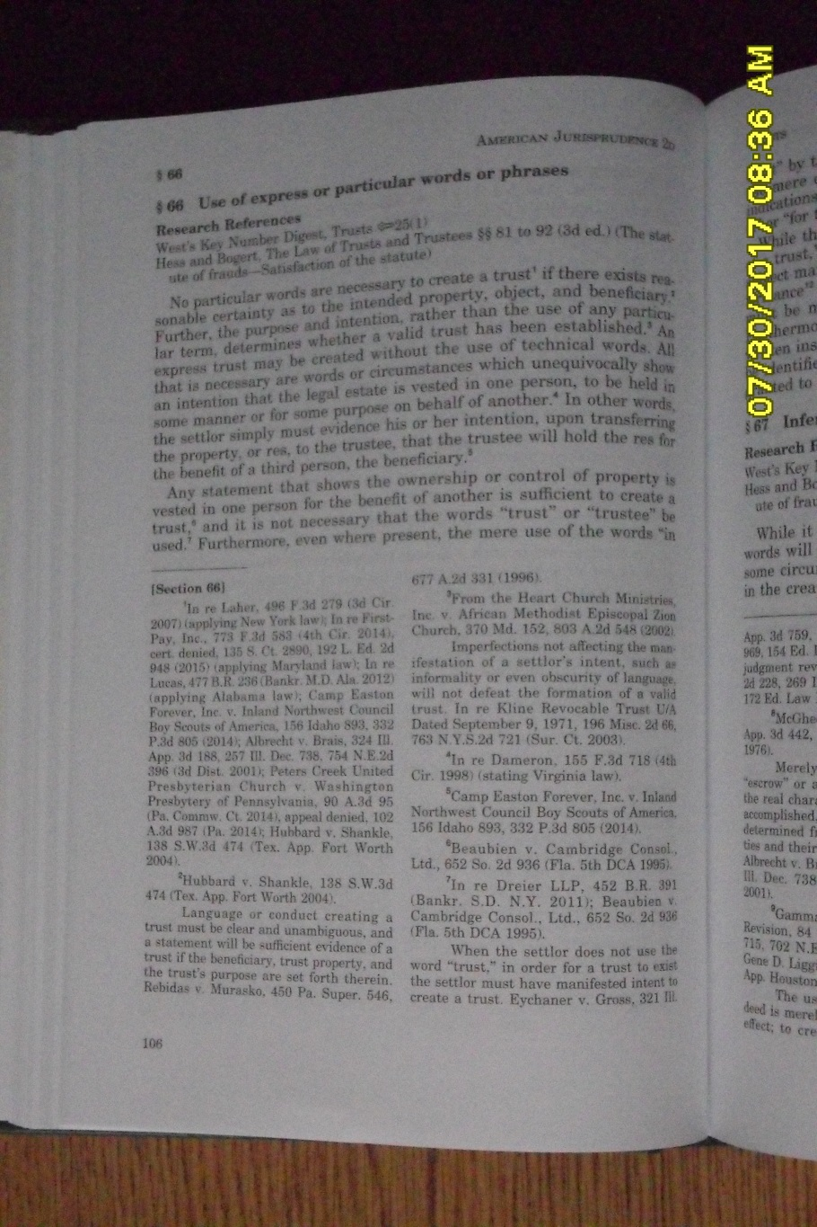
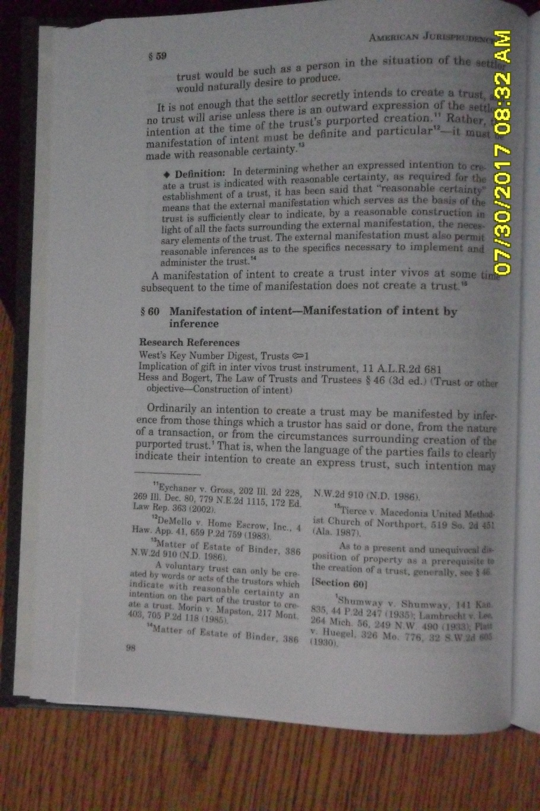
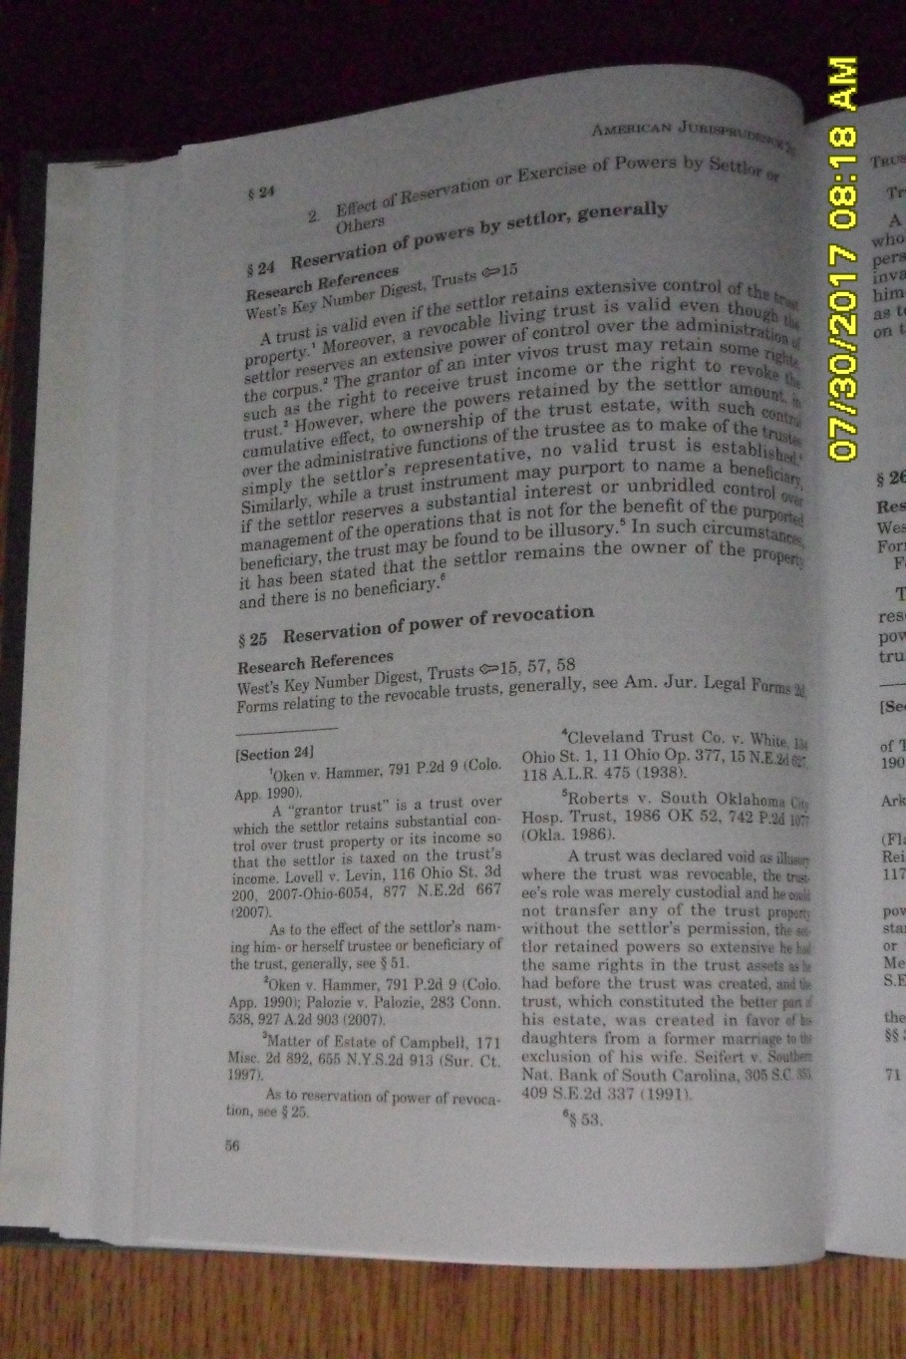
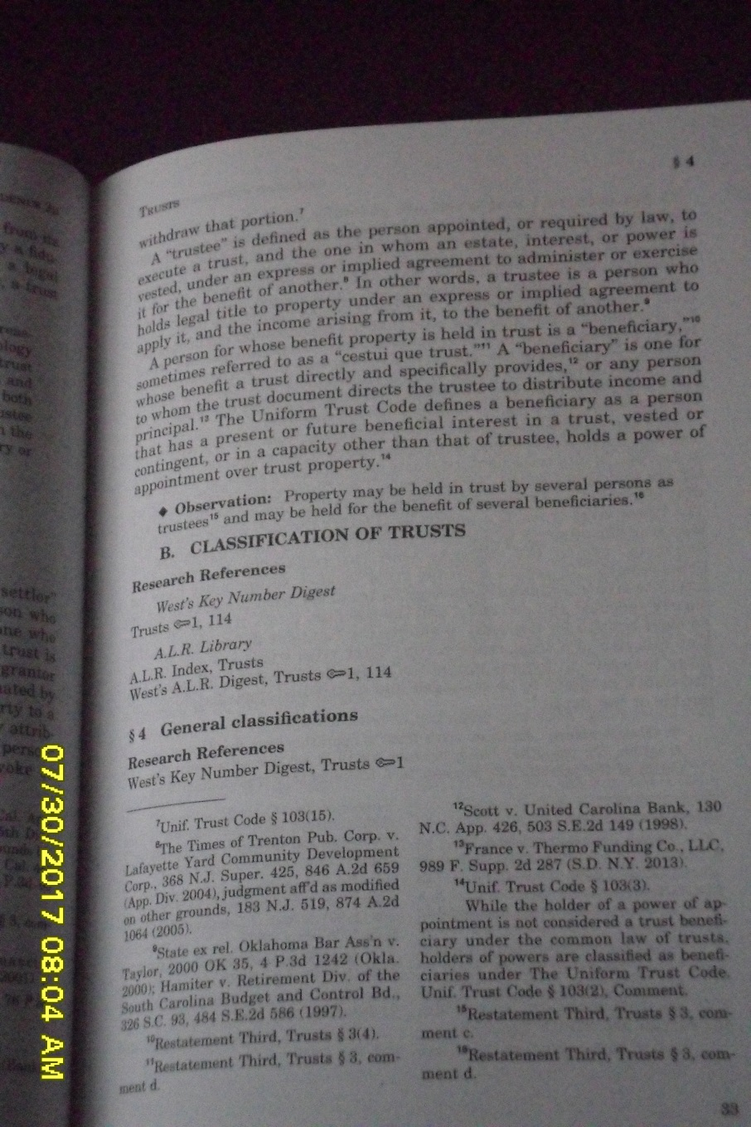
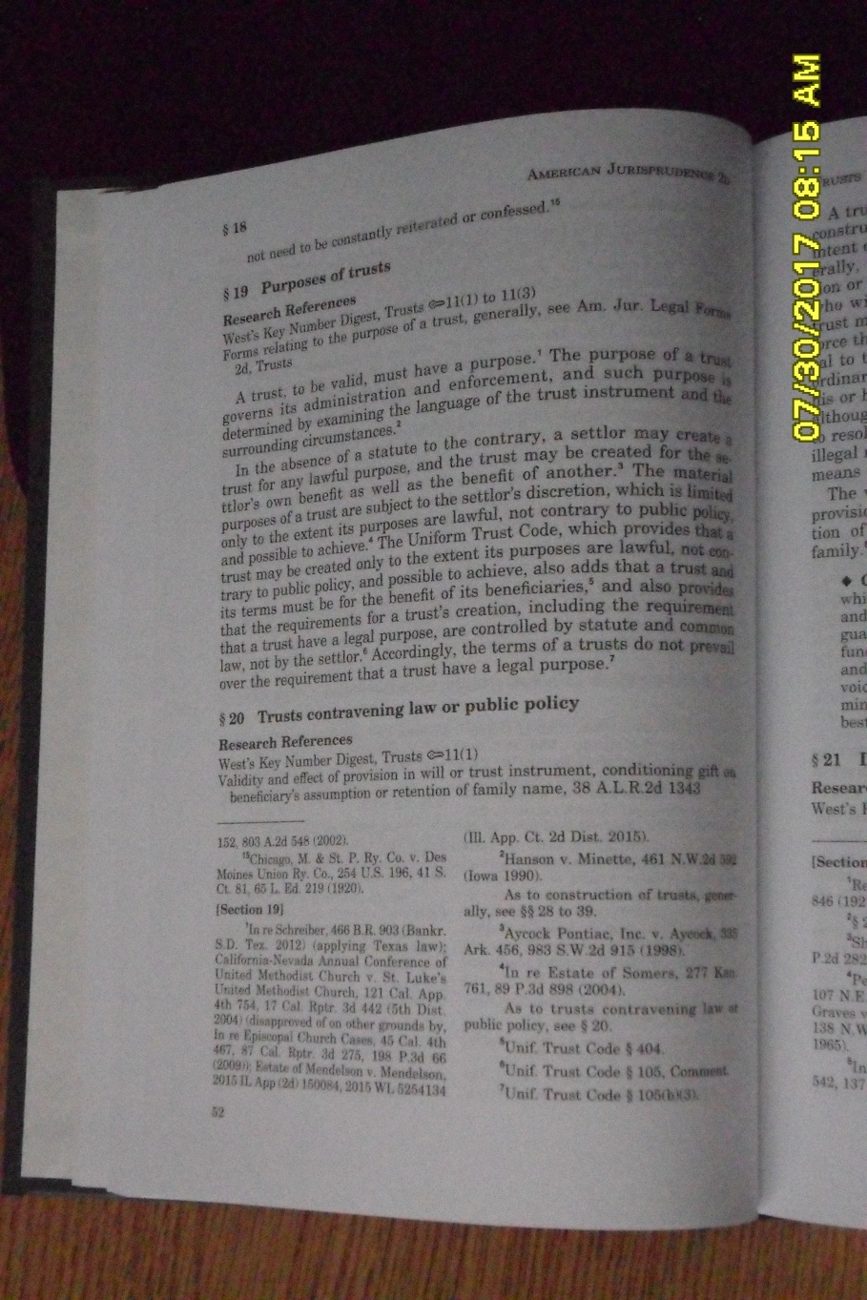
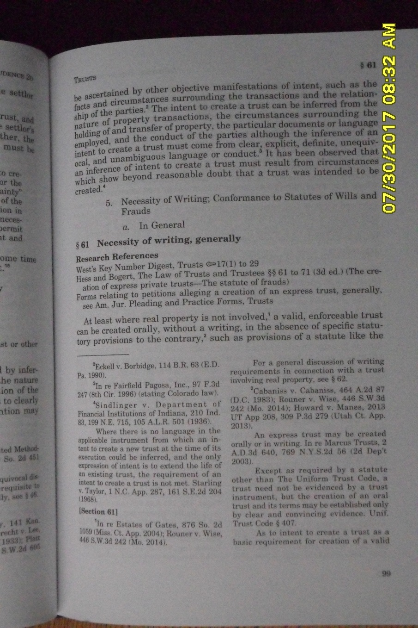
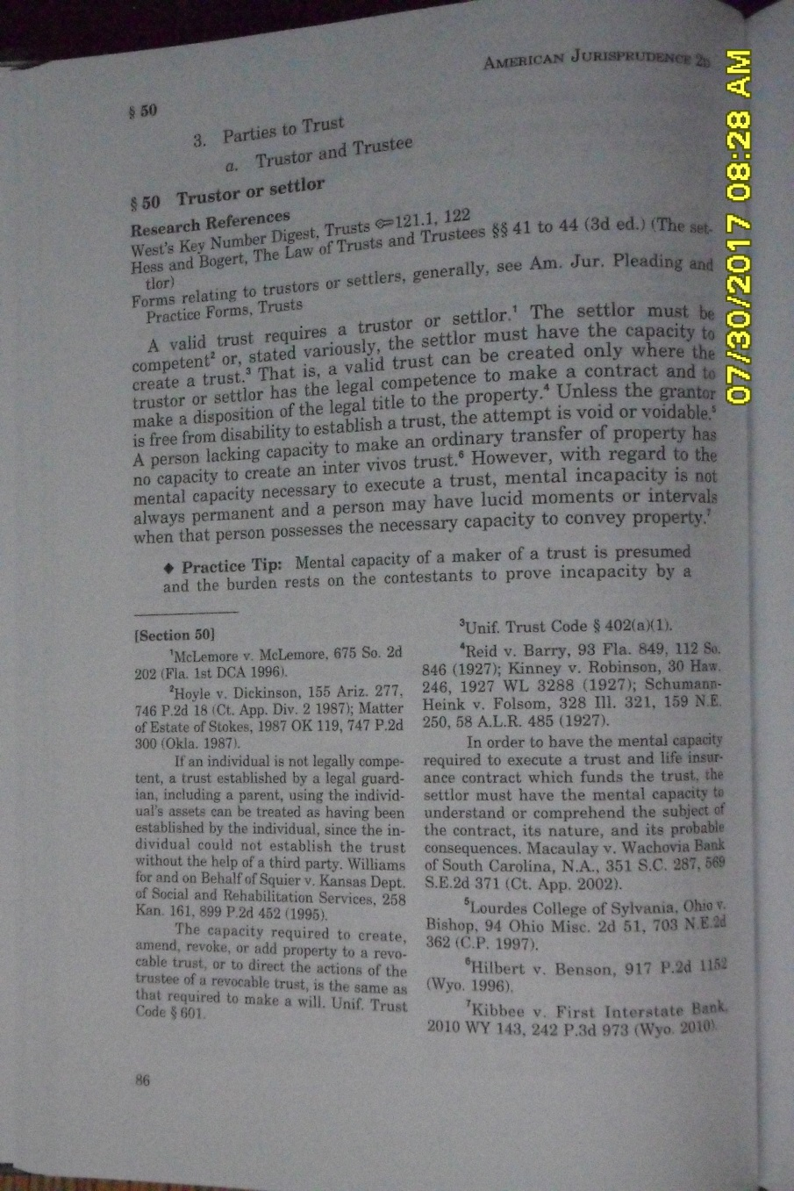
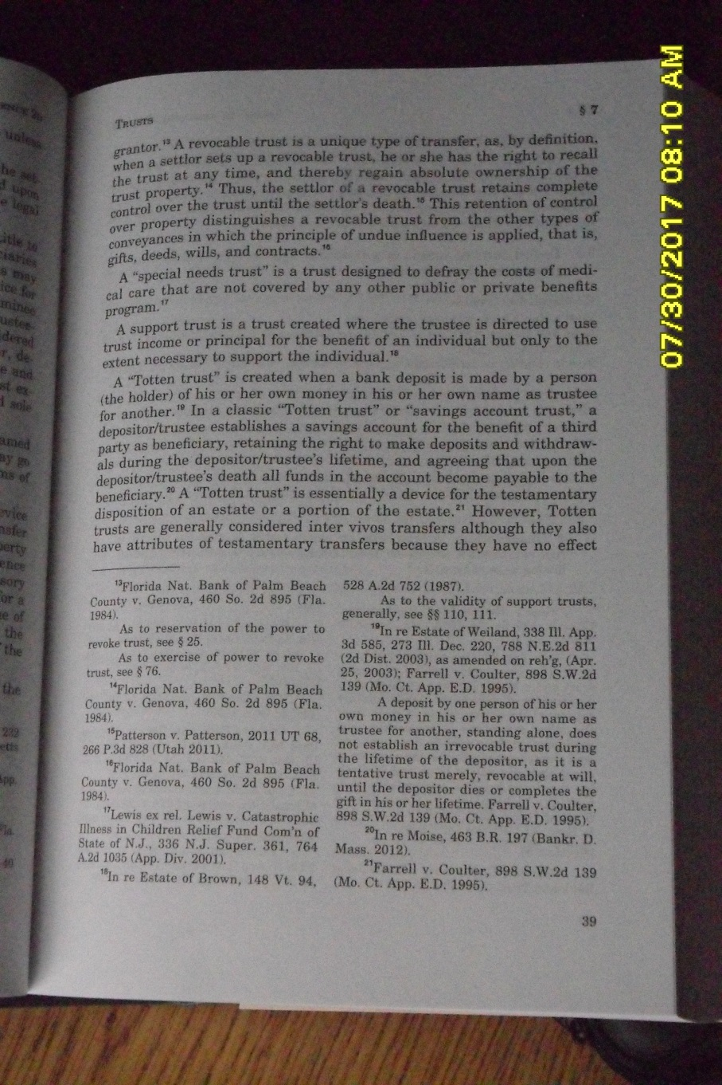
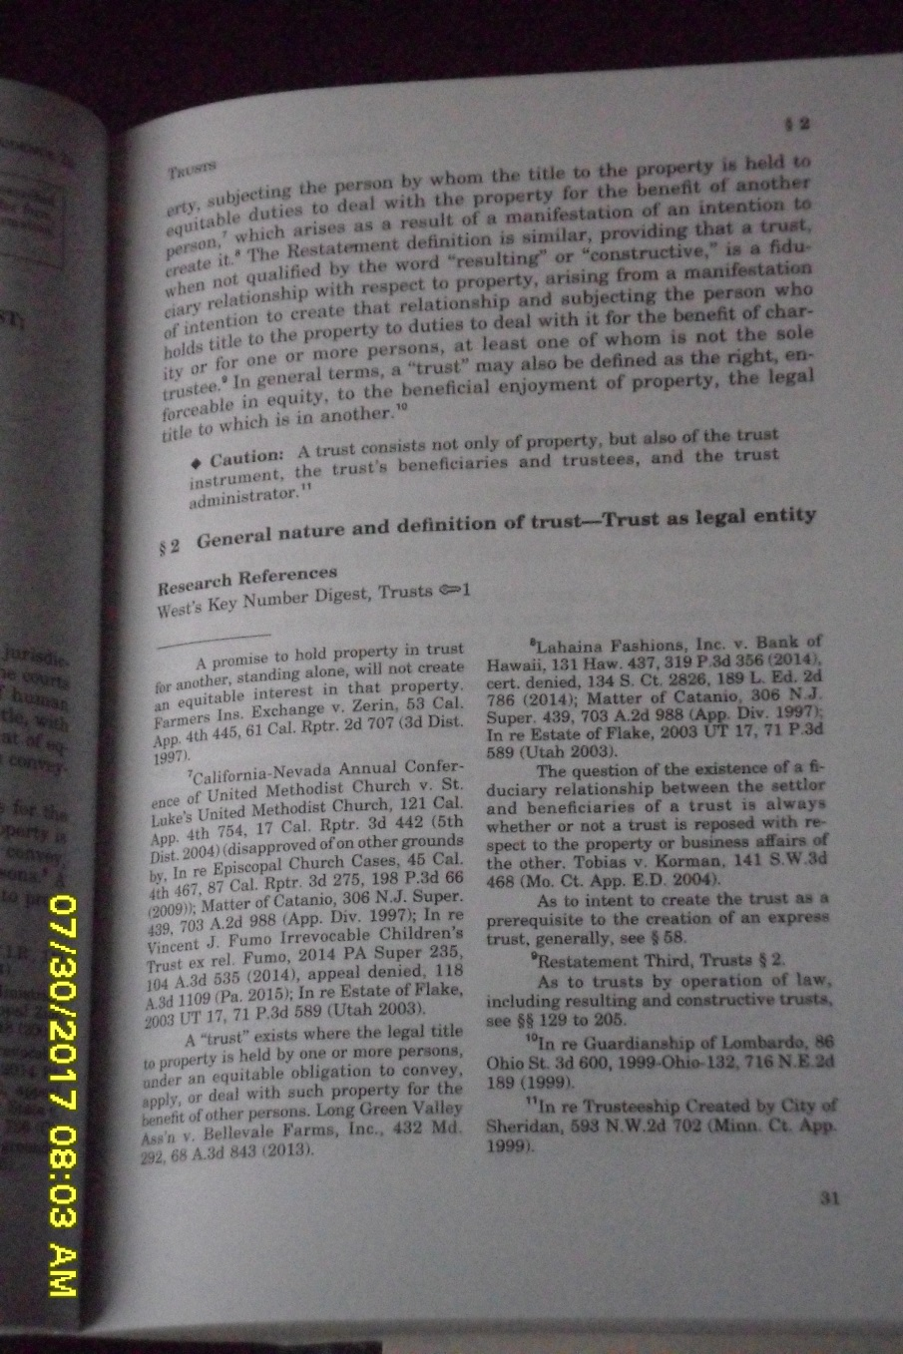
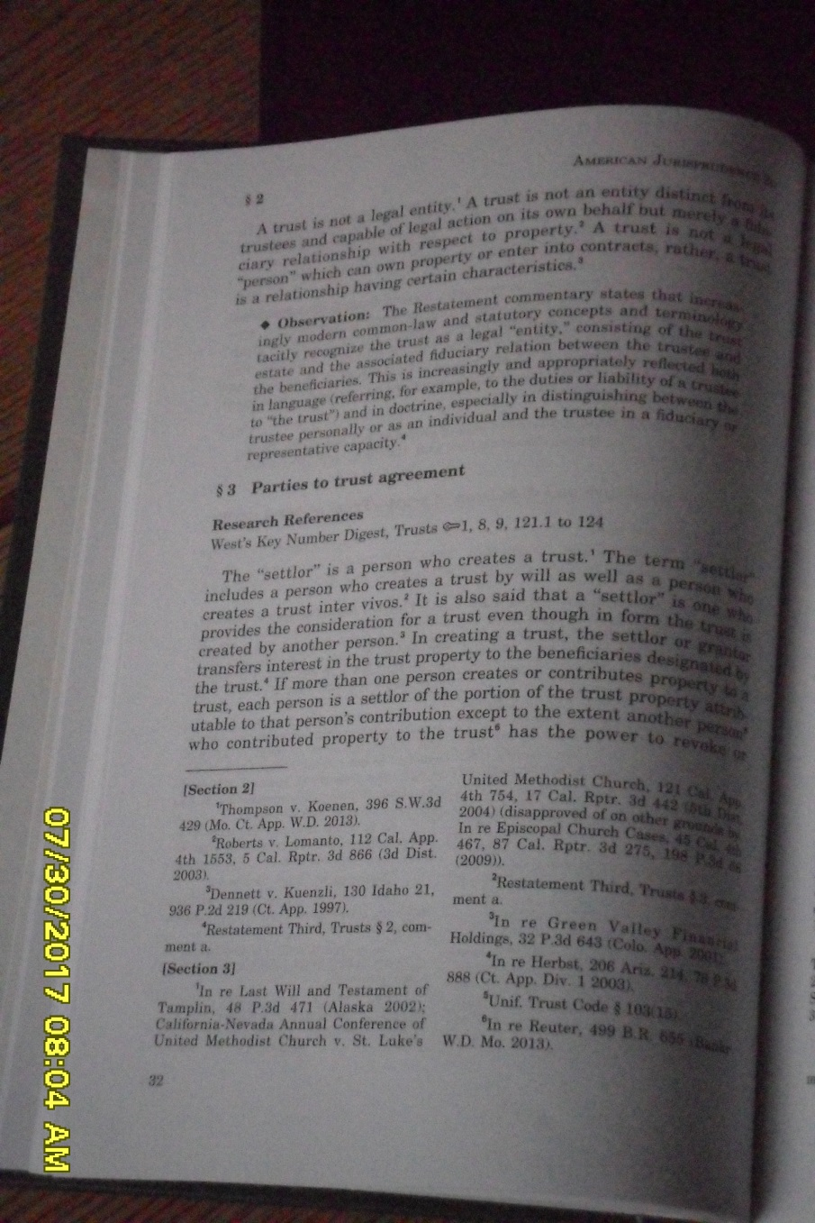
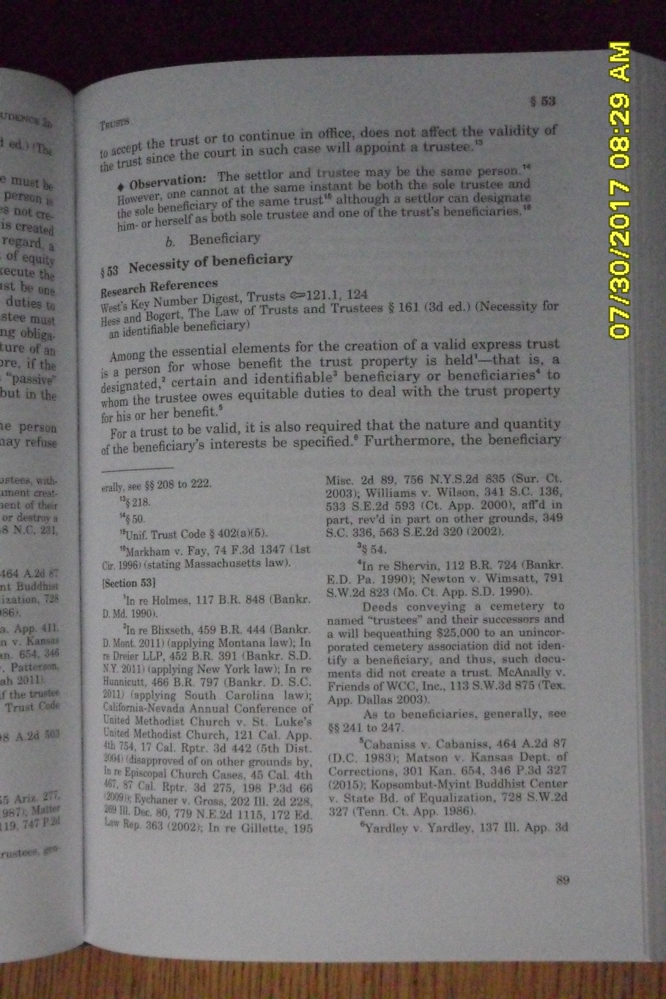
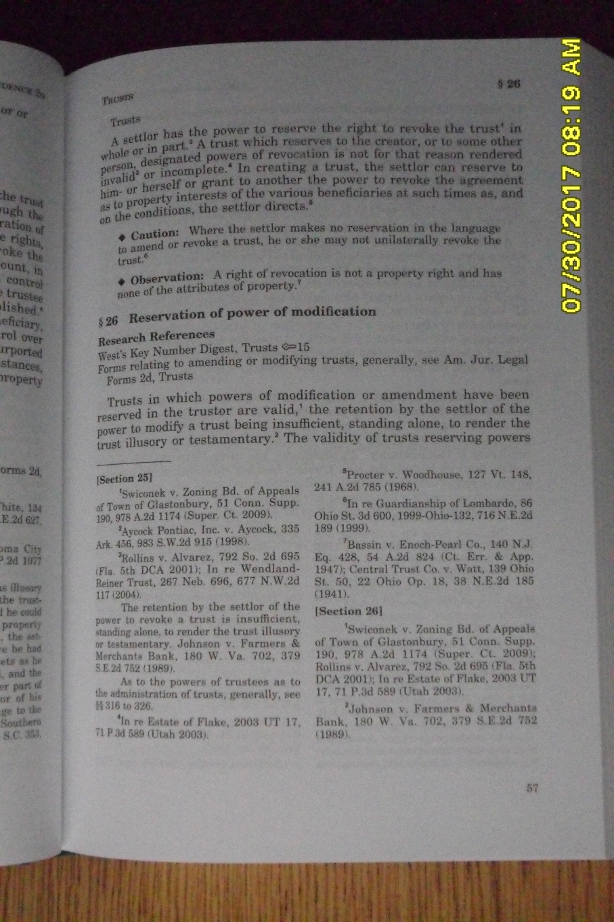
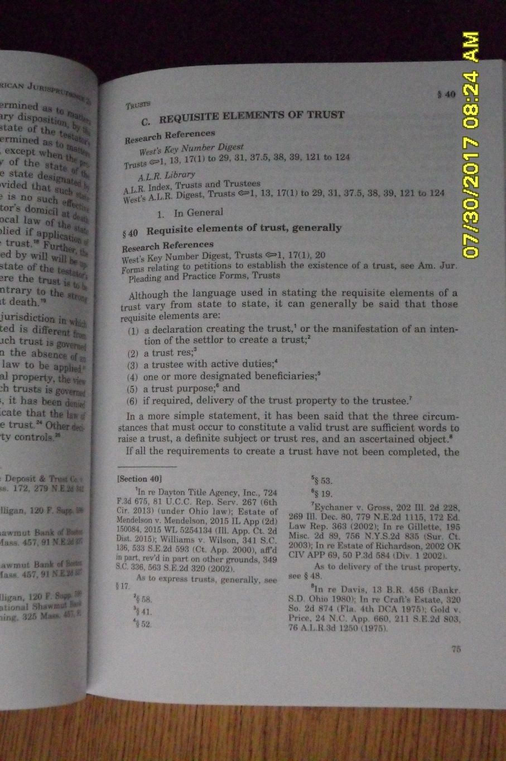
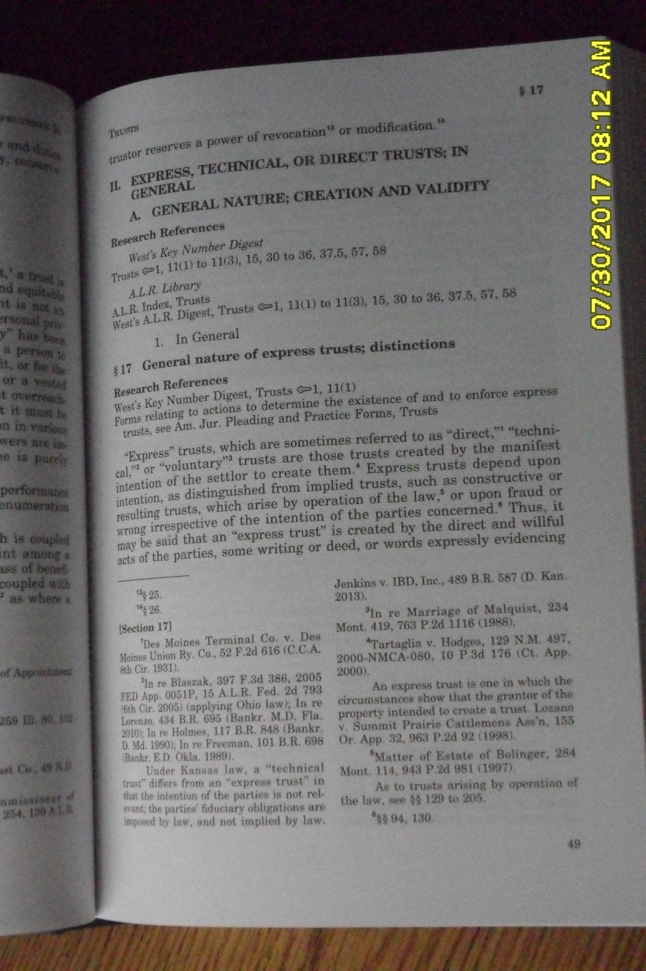
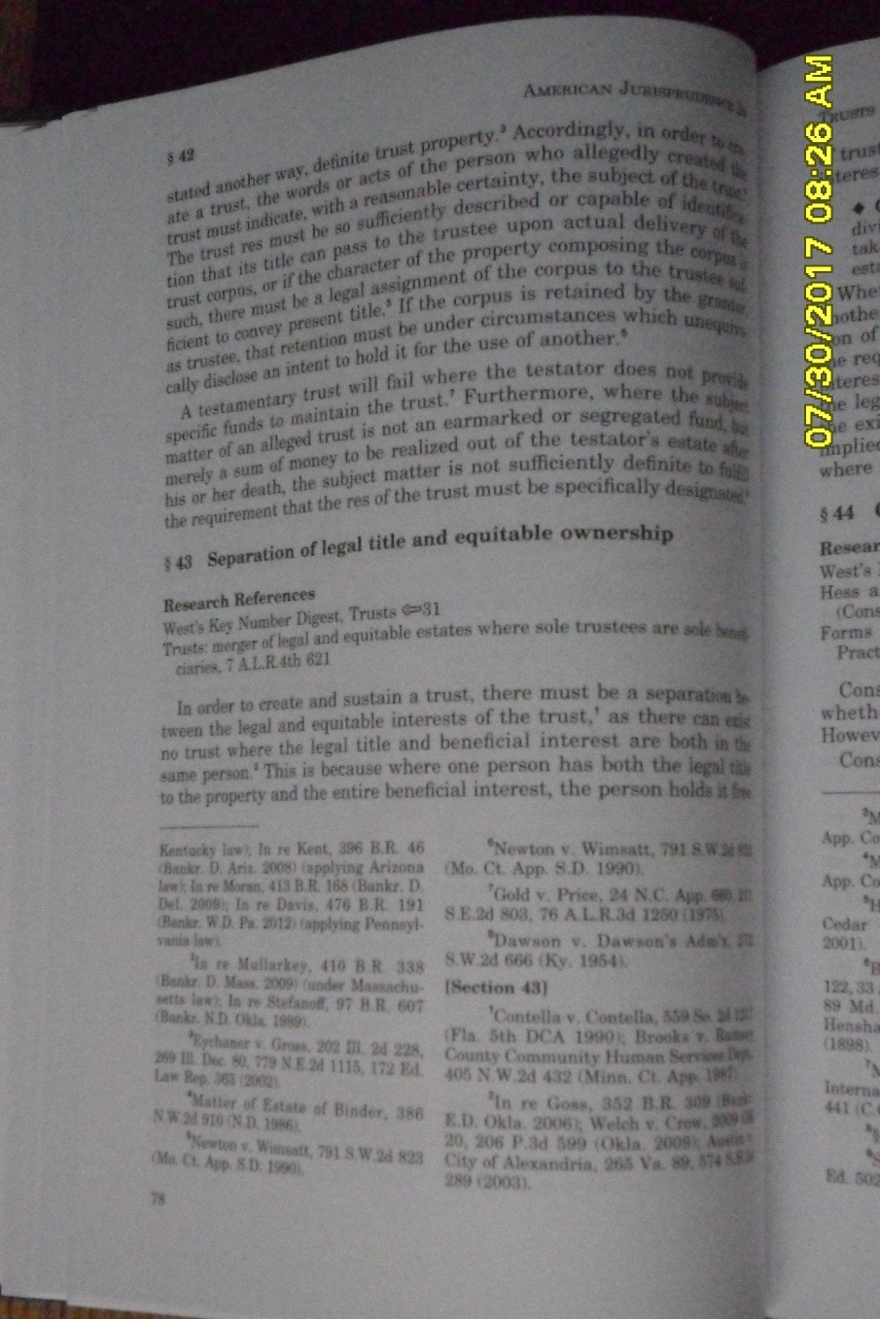
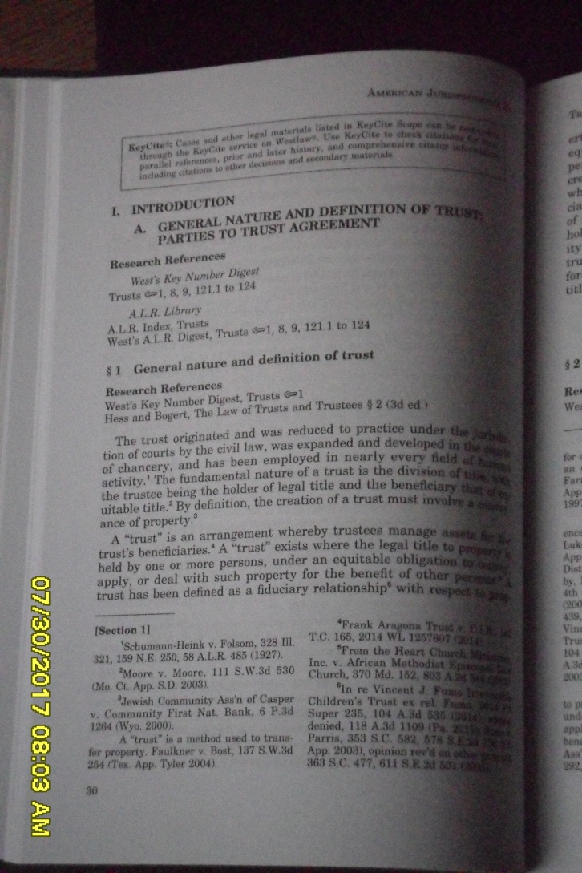
2016 AmJur 2d “Trusts”
Notes:
Now let’s just look at a little of what is in volume 76. Go over the slides, emphasizing and reading from some and explaining them in context.

Slide 24
A Practical Question
I have been asked, “I know a couple of pastors who opened bank accounts in their name to hold and manage tithes and offerings. The IRS is questioning the source, etc. of the funds. What should they do?”
Notes:
They can hold the position that they are the trustees of a trust, an oral trust. A trust can be created and operated without a writing. However, how do they explain the trust? Thus, the wisdom of a writing, a Resolution and a Declaration of Trust, properly worded and properly executed. Such a document will answer all their questions. See the article for more on the wisdom of a DOT.

Slide 25
Unlearned Questions
I have been asked, (1) “Has it been tested in court?” and (2) “Does the court have jurisdiction over it?” Answer: (1) It has been recognized in court - we will show that in presentation 2. (2) No. I elaborate: …

Slide 26
I believe and teach that the only way a church can organize according to Bible principles is to utilize the God-given concept of trust. I leave the door open for anyone to tell me some other way. If you believe the church and state should unite, that a church should incorporate or become a legal entity in any way, then we first have to resolve that matter. However, if you believe as I do that a church should remain a spiritual entity only and that you know another way for a church to do so, please let me know. We can sit down and talk or arrange a time to do so. If you show me another way, and can back up what you say with the Bible, I will accept the new light you present and will make it known.

Slide 27
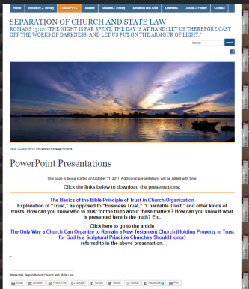
This PowerPoint and accompanying article are free online.
Online page with links.
This PowerPoint is online and downloadable:
The link is:
https://jeraldfinney.wordpress.com/audio/powerpoint-presentations/.
To download, just click the link. It’s that easy!

